Slide 1
6. Model Part 1

Slide 2
Model Part 1 - Topics
Koyck Structure with one variable (say Details)
Introduce OLS Model Structure (similar to Paul Allison)
OLS Model Structure, residuals & N(IID) assumptions
Deviations from Distribution Assumptions
Deviations from Independence Assumptions
Multi collinearity
Lagged variables independence violation on Residuals
Dealing with Multicollinearity
Bias introduction in estimates
Principal Components – Concepts, Code Usage (Princomp)
Ridge regression
Step Models
Dealing with Error Dependencies
Robust standard errors
Mixed Effects models with Correlation Structures - Intro
Belsomra Example

Slide 3
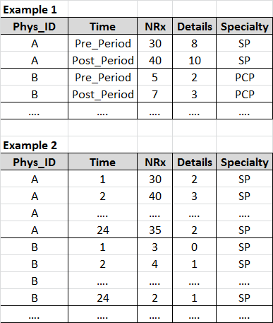
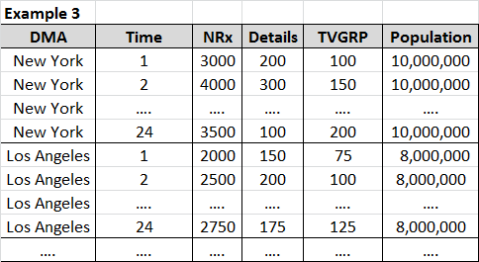
Longitudinal or Panel Data
Has data that changes over time for each of the individuals in the data. Examples are listed:

Slide 4
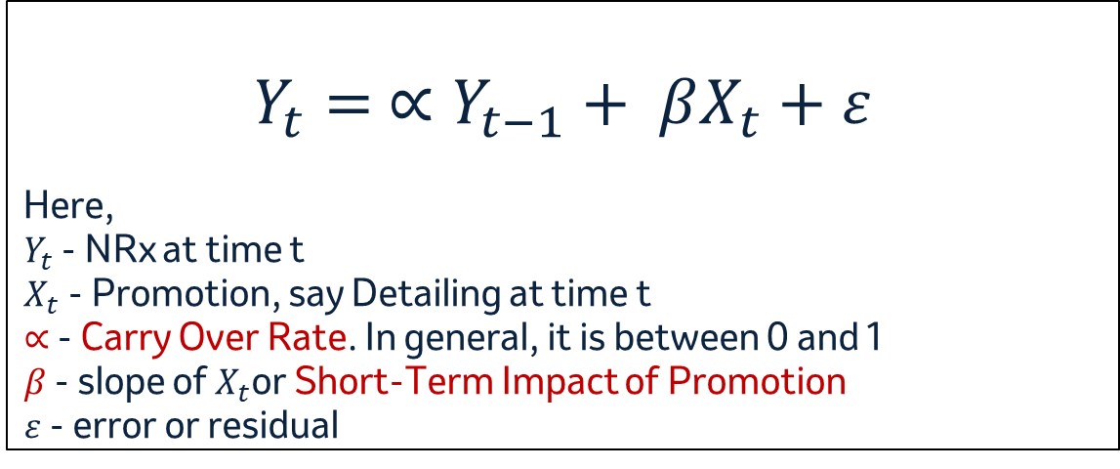
Koyck Model Form
$$Y_{t}= ∝Y_{t−1}+ βX_{t}+ε$$
Here,
${ Y}_{t}$ - NRx at time t
${ X}_{t}$ - Promotion, say Detailing at time t
$∝$ - Carry Over Rate. In general, it is between 0 and 1
$β$ - slope of $X_{t}$or Short-Term Impact of Promotion
$ε$ - error or residual

Slide 5
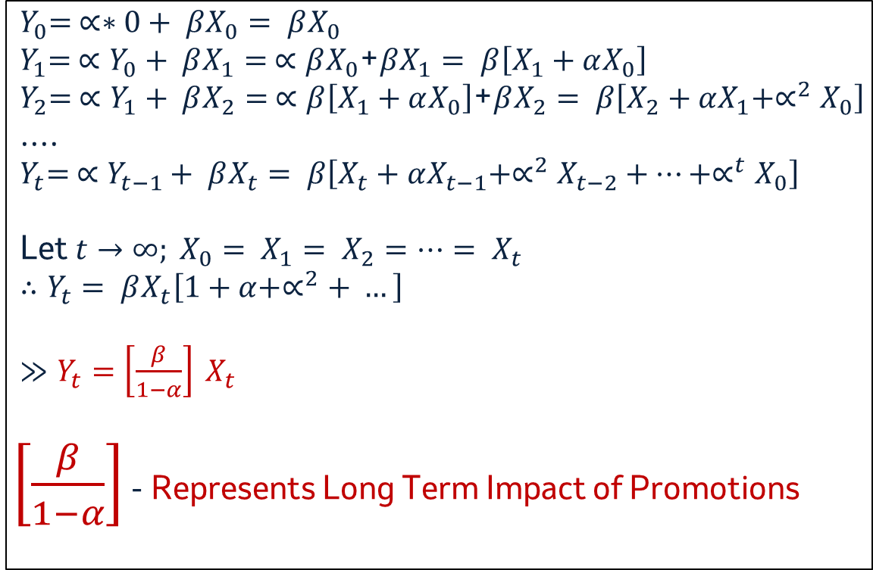
Koyck Model Details
$${ Y}_{0}= ∝∗0+ βX_{0}= βX_{0}$$
${ Y}_{1}= ∝Y_{0}+ βX_{1}= ∝βX_{0}$+$βX_{1}= β\left[X_{1}+αX_{0}\right]$
${ Y}_{2}= ∝Y_{1}+ βX_{2}= ∝β\left[X_{1}+αX_{0}\right]$+$βX_{2}= β\left[X_{2}+αX_{1}+∝^{2}X_{0}\right]$
....
$${ Y}_{t}= ∝Y_{t−1}+ βX_{t}= β\left[X_{t}+αX_{t−1}+∝^{2}X_{t−2}+…+∝^{t}X_{0}\right]$$
Let $t→∞; X_{0}= X_{1}= X_{2}=…= X_{t}$
$$∴Y_{t}= βX_{t}\left[1+α+∝^{2}+ …\right]$$
$≫Y_{t}=\left[\frac{β}{1−α}\right] X_{t}$
$\left[\frac{β}{1−α}\right]$ - Represents Long Term Impact of Promotions

Slide 6
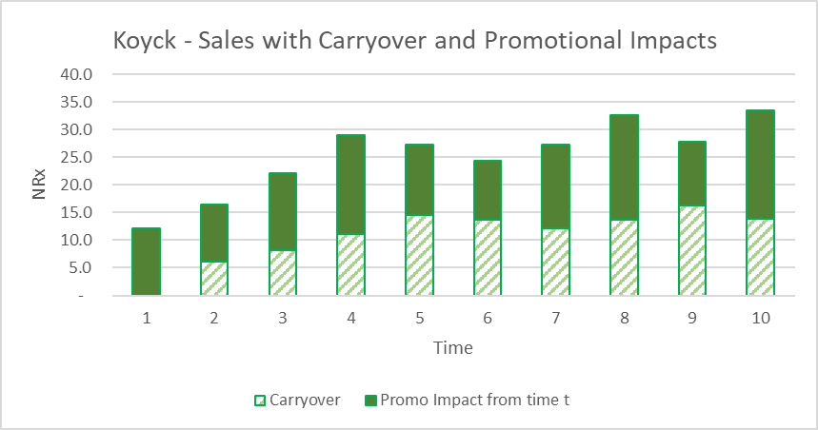
Estimated Sales from Koyck Models

Slide 7
Short-Term Impacts and Carryover Estimates
Merck’s (US) Practice is to use only Short-Term Impact of Promotions (i.e., beta values or slopes)
Since the model results inform yearly or few years of budgets and impacts, only short-term impacts are considered
Typically, alphas, the carry over factor, range between 0 to 1.
Launch brands have low alpha – products are not established in the market yet
Mature brands have high alpha – much of sales comes from persistency in script writing (high carry over)

Slide 8
Ordinary Least Square (OLS) Regression
Basic Model
Y_{it,} X_{it} is response and time variant variables for individual i and time t. Z_{i} time-invariant variables in the model
ε_{it} is random error with mean 0 and constant variance, uncorrelated with x and z. β, γ parameter estimates. Different intercepts at each time point, coefficients are same across times.

Slide 9
Ordinary Least Square (OLS) Regression
Example
OLS (PROC REG):
Coefficients will be unbiased but NOT efficient (true standard errors will be larger than necessary)
Estimated standard errors and p values will be too low because error covariance across time ≠ 0.
PROC REG (or PROC GLM)
$$NRx_{i1}=t_{1}+t_{2}+...+t_{24}+β_{1}Det_{i1}+β_{2}Samp_{i1}+γ_{1}Spec_{i}+ε_{i1}$$

Slide 10
Deviations from Distributional Assumptions
Both dependent & independent variables usually do not follow Normal Distributions – violating a primary assumption in OLS.
OLS’s slope estimates are impacted (i.e., biased). Simulations suggest that the OLS estimates are bit tolerant to these violations.
Variable transformations could help to lower the deviations – Power, negative binomial etc.
Our dependent variables (NRx, Doses etc) are generally count based with values 0 or higher.
In this case, Poisson Regression or Negative Binomial Regression could help to some extent.

Slide 11
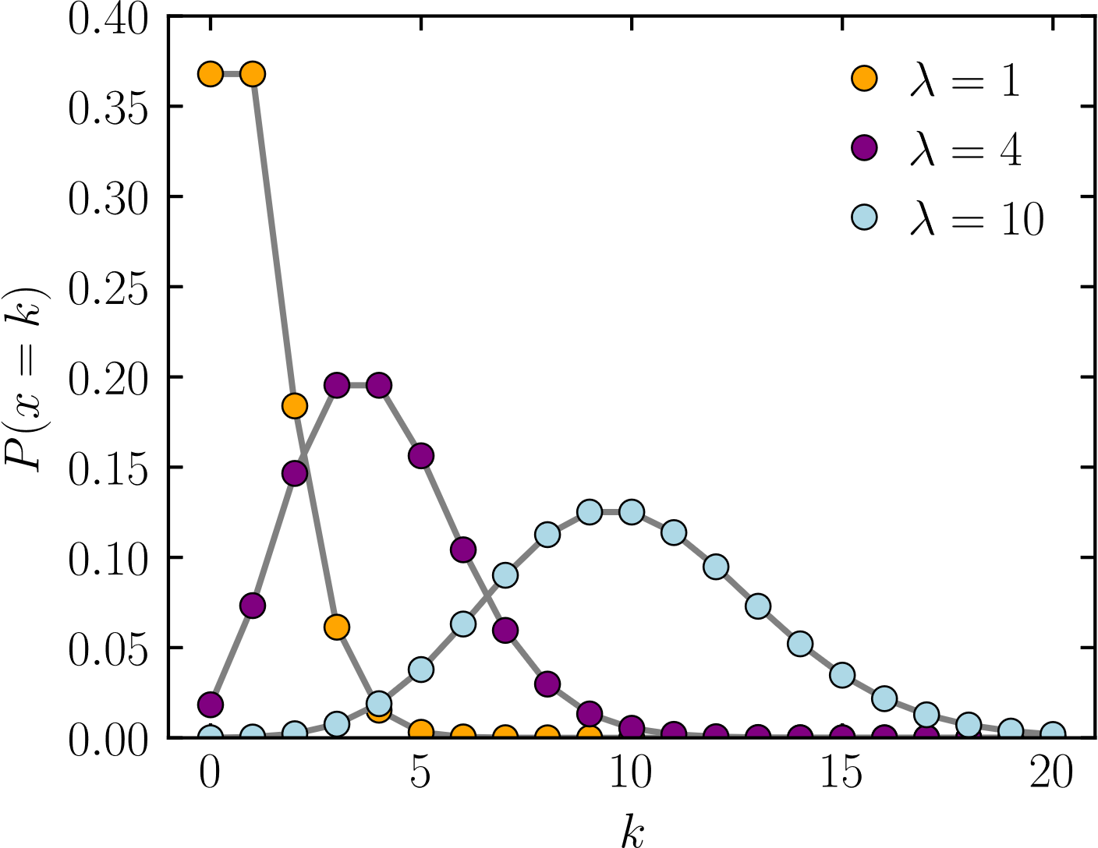
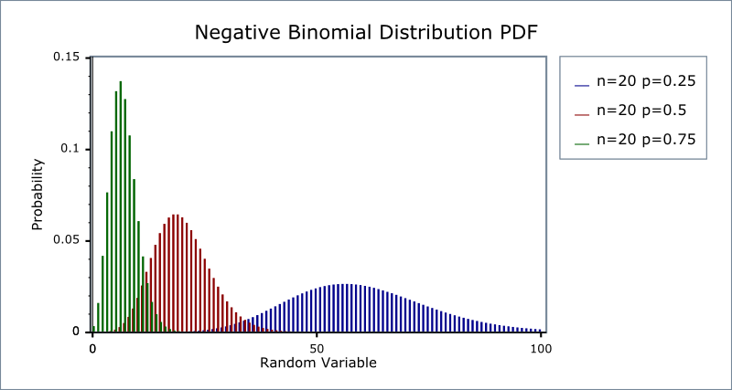
Poisson & Negative Binomial Regressions
Poisson Distribution - Shapes
Negative Binomial Distribution - Shapes
proc genmod data=insure;
class car age;
model c = car age / dist = poisson link = log offset = ln;
run;
proc genmod data = nb_data;
class prog (param=ref ref=first);
model daysabs = math prog / type3 dist=negbin; run;
Poisson distribution image by Skbkekas - Own work, CC BY 3.0, https://commons.wikimedia.org/w/index.php?curid=9447142
Negative binomial distribution from UCSF (https://valelab.ucsf.edu/svn/3rdpartypublic/boost/libs/math/doc/sf_and_dist/html/math_toolkit/dist/dist_ref/dists/negative_binomial_dist.html)

Slide 12
Deviations from Independence Assumptions - Multicollinearity
A more serious violation that biases slope estimates (Belsomra Example)

Slide 13

Deviations from Independence Assumptions – Time dependency
By introducing one or more lagged dependent variable (NRx (t-1)), we artificially introduce dependency in the residuals.
Field of Forecasting addresses such error dependencies (ex: ARIMA)
In our case, we introduce lagged NRx to account for carry over.

Slide 14
Dealing with Multicollinearity

Slide 15
Multicollinearity – Issues
High degree of correlation among several promotional and other independent variables violates variable independence assumptions – often resulting in high standard errors / p-values.
Large number of observations may be needed to get a significant p-value, but still do not guarantee unbiased estimate.
Introducing a smaller number of correlated variables is common, however, important promotions - the objective of marketing mix models – may be left out. In addition, the remaining variables may contain impacts from the missing variables.
Mathematical techniques exist to reduce multicollinearity; however, the estimated regression coefficients are biased.
Balancing bias vs reduction in multicollinearity is a time-consuming modeling task involving multiple model trials.

Slide 16
Issues and Solutions with Multicollinearity (cont’d)
Below are the issues while modeling with variables
The coefficient estimates can swing wildly based on which other independent variables are kept in the model. The coefficients become very sensitive to very small changes in the model.
Multicollinearity reduces the precision of the estimated coefficients, which weakens the statistical power of your regression model. You might not be able to trust the p-values to identify independent variables that are statistically significant
Probable solutions that can used to resolve the multicollinearity issue –
Remove some of the highly correlated independent variables.
Linearly combine the independent variables, such as adding them together and include them in the model
Perform an analysis designed for highly correlated variables, such as principal components analysis or partial least squares regression.
LASSO and Ridge regression are advanced forms of regression analysis that can handle multicollinearity.

Slide 17
Detecting Multicollinearity
Study of correlations helps in understanding the presence of multicollinearity.
Note that the correlation of single variable may be low, but a combination of variables may be correlated with another combination of variables – such relations are hard to estimate through correlation tables.
Relative significance of the model and the individual parameter estimates
Overall model being highly significant and individual parameter estimates being not so significant likely points to the existence of multicollinearity (as one factor)
Variance Inflation Factors (VIF)
Analysis of structure of the X’X matrix
# Diagnostics of VIF and Structural Analysis of X’X using VIF and COLLINOINT options.
PROC REG data=xxx; model y = x1 x2 x3 x4 / vif collinoint; run;

Slide 18
Variance Inflation Factors (VIF)
Used in determining which variables may be involved in multicollinearity.
VIF shows how multicollinearity has increased the instability of coefficient estimates.
VIF may be interpreted as the factor by which variance of estimated coefficients is larger than it would be if there were no multicollinearity
No formal criteria to determine magnitude of VIF. Depends on the data at hand.
VIF value of 1 is ideal – indicating no multicollinearity. Less than 1 represents modeling issues or instabilities.
For our domain we seek a VIF close to 1 – ranging up to 2. Higher than these values suggest reducing VIF by breaking multicollinearity through other techniques (Principal Components, Ridge Regression etc)

Slide 19
Example of BELSOMRA (Multicollinearity)
Variable | DF | Estimate | StdErr | tValue | P-Value | Variance Inflation
Intercept |  | -1267.26 | 50.01 | -25.34 | 0.00 | 0.00
hcc_osrch_sessions | 1 | 0.34 | 0.03 | 13.47 | 0.00 | 8.79
hcc_psrch_clk | 1 | 0.13 | 0.01 | 24.93 | 0.00 | 8.45
hcc_soc_imp | 1 | 0.00 | 0.00 | 12.79 | 0.00 | 7.16
hcp_disp_imp | 1 | 0.00 | 0.00 | -0.17 | 0.86 | 1.43
hcp_grail_nrx_lag | 1 | 0.75 | 0.01 | 104.71 | 0.00 | 11.95
hcp_grail_sdot | 1 | 0.00 | 0.00 | 3.89 | 0.00 | 3.25
hcp_grail_vnrx | 1 | 0.09 | 0.10 | 0.96 | 0.33 | 1.70
hcp_npp_eng | 1 | -0.07 | 0.00 | -14.87 | 0.00 | 6.52
hcp_osrch_sessions | 1 | -0.94 | 0.14 | -6.86 | 0.00 | 6.86
hcp_rdtl_totdet | 1 | 0.06 | 0.01 | 8.37 | 0.00 | 6.24
We can observe the consumer channel variables show high VIF’s values (> 5) that makes not a fit model.

Slide 20
Principal Components
Principal Components are the linear transformation of variables in such a way that the resulting principal components are orthogonal (i.e., zero correlation). N variables produces N principal components.
No loss in information, however, using all components does not improve the significance of the underlying raw variable
Use first few components, representing ~90% or more of variation in the data and include them in the model. Results in BIASED coefficient estimate as information is dropped.
Interpretation of Principal Components are not straight forward – a key hurdle in inference of promotional impact.
PROC PRINCOMP data = xyz out = prin;
VAR x1 x2 x3 x4 x5; run;

Slide 21
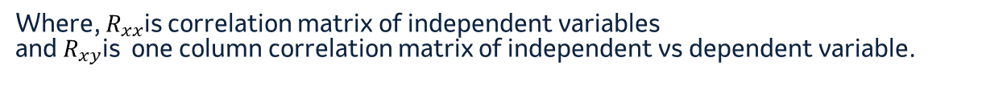

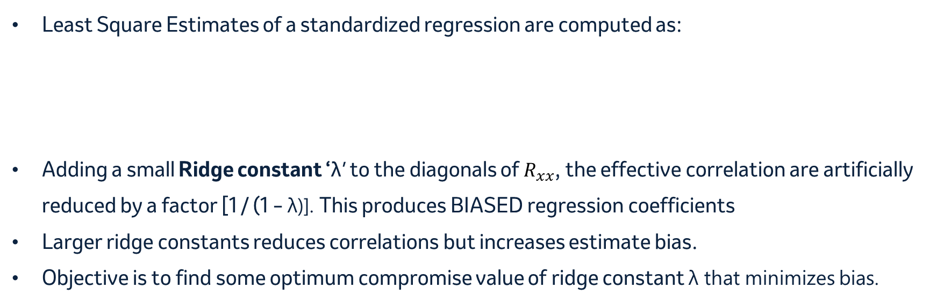
Ridge Regression
Least Square Estimates of a standardized regression are computed as:
Adding a small Ridge constant ‘λ’ to the diagonals of $R_{xx}$, the effective correlation are artificially reduced by a factor [1 / (1 – λ)]. This produces BIASED regression coefficients
Larger ridge constants reduces correlations but increases estimate bias.
Objective is to find some optimum compromise value of ridge constant λ that minimizes bias.
$\hat{β}=R_{xx}^{−1}R_{xy}$
Where, $R_{xx}$is correlation matrix of independent variables
and $R_{xy}$is one column correlation matrix of independent vs dependent variable.

Slide 22
Ridge Regression
For our datasets, try ridge constants from 0 to 0.3 (or so) with an interval of ~0.01. Choose the minimum ridge which reduces VIF sufficiently and produces meaningful regression coefficients for variable of interest (i.e., select promotional variables)
Optimal ridge finding mathematical methods usually produces high λ. Avoid such methods as they produce highly biased estimates
PROC REG data=xyz outset=out outseb noprint;
MODEL y = x1 x2 x3 x4 / ridge = 0 to 0.2 by 0.01;
PLOT /ridgeplot; # Optional - plots the estimate changes for each variable and each ridge constant.
RUN;

Slide 23
Ridge Model Output – Example from Belsomra Mkt Mix Models
0.05 is a reasonably minimum ridge constant that reduces the “display’ VIF to under 2.

Slide 24
Step Model
Let us say, Display and Social are highly correlated. Introducing both variables together causes instability (i.e., high std errors & estimate bias) in estimates
Step 1: Model with all covariates and Display variable. Then, subtract out Displays impact from NRx.
$$NRx= Y_{1}=t_{1}+t_{2}+...+t_{24}+β_{1}Det+β_{2}Samp+β_{3}Disp+ε_{1}$$
$$then compute \hat{Y_{2}}=Y_{1}−β_{3}Disp$$
Step 2: Model the predicted dependent var without display component with all covariates and Social variable.
$$\hat{Y_{2}}=t_{1}+t_{2}+...+t_{24}+β_{1}Det+β_{2}Samp+β_{4}Social+ε_{1}$$

Slide 25
Dealing with Error Dependence

Slide 26
Robust Standard Errors
Basic Model
Y_{it,} X_{it} is response and time variant variables for individual i and time t. Z_{i} time-invariant variables in the model
Correlation structure is explicitly assumed in certain mathematical way for ε_{it} . This produces same efficient estimates as OLS however the standard errors of the estimates are now larger (i.e., larger p-values) to account for uncertainty in the parameter estimates.

Slide 27
Generalized Estimating Equations, Mixed Effects Models
A large variety of covariance structures could be assumed for the error term and the model estimates obtained accordingly.
Difficulty is in choosing the correct error term covariance structure – a challenge that involves understanding the underlying problem being solved (i.e., time series models, special correlations etc)
Allowing regression to estimate the error covariance without any restrictions sometimes leads to loss of degrees of freedom and estimate instability.
In Mixed effects model with random component, the random variable’s estimate (i.e., random estimate) is assumed to follow a distribution with mean and variance.
Mixed effects model is a large subject area and is not covered in the current session.

Slide 28
Code walk through – Belsomra / G9 Examples

Slide 29
Appendix Exploring Residuals, Covariance Structures from Nasonex Mixed Effects Models

Slide 30
Randomness in Residuals from Models
Exploring Residuals of a model for randomness in different dimensions (like, time and GRPNAS) might help to identify further tuning of model structures. In the example below, Model A is better.
MODEL A (with time indicators): MODEL C (with seasonal indicators):
TIME vs. Residuals AND GRP vs. Residuals TIME vs. Residuals AND GRP vs. Residuals

Slide 31
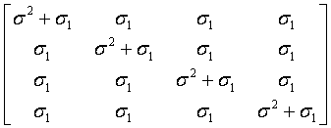
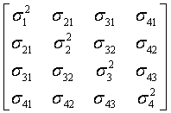
Covariance Structures - Examples
Variance Components
VC (default)
Compound Symmetry
CS
Unstructured
UN
First Order Auto Regressive
AR(1)
Toeplitz
TOEP
Spatial Power
SP(POW)(c)

Slide 32
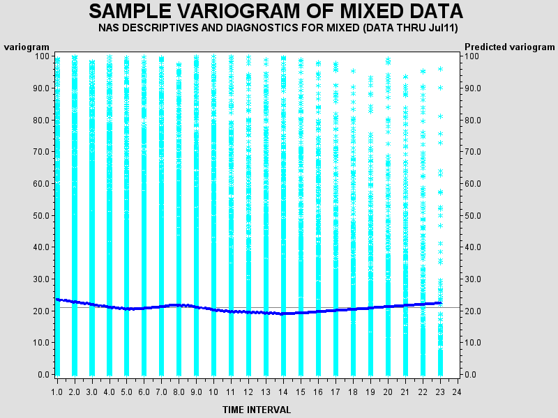
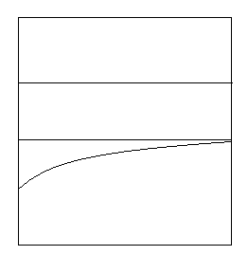
Variograms
Variograms (time vs. variance components) helps in visualizing the total variance and how they are split into component variances like Measurement Error, Repeated Measures and Random Component.
Variogram Macro provided by SAS is used to get the variograms for the given data.
Nasonex DTC data shows a large Measurement Error component and a small wavery Repeated Measures component. It appears that Random Effects Component exists within Measurement Error portion.

Slide 33
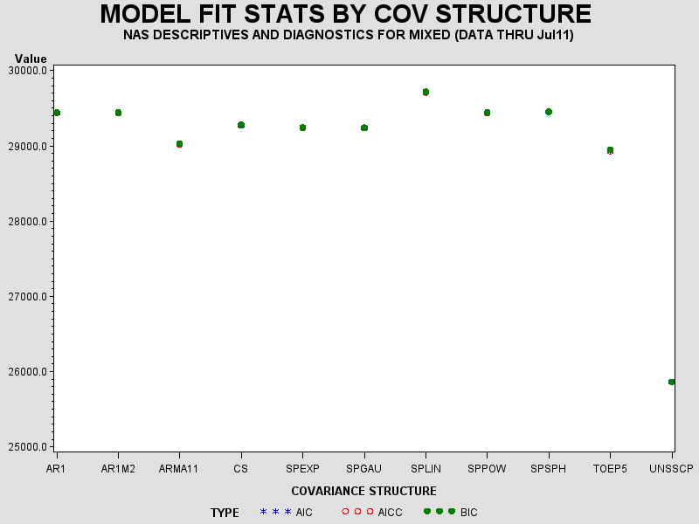
BIC’s from Various Repeated Measures Covariance Structures
Variogram Macro also produces BIC values generated by various Repeated Measures covariance structures.
Below, Unstructured (with SSCP option), TOEP5 and ARMA11 have lower BIC’s, but we do see some convergence issues (observed through exploration of residuals and observation of very different patterns and values in predicted covariance matrices)

Slide 34
Convergence Issues – Seems Common
Issues with Covariance Structures
Lot of changes in estimated values, probably due to local convergence. Look for convergence issues in predicted covariances.
BIC alone may not be an indicator of better model. Check to see if BIC, Estimate magnitudes and Signs makes some sense as well.
Look if the final model marginal residuals (after introducing covariance structures) have no structure.
When convergence is an issue, a simpler covariance structure may suffice (probably only option).
At times, estimated G matrix is not positive definite that leads to NULL covariance estimate. Look to see if other covariance structures helps to address the issue.
Example:
The Final Model covariance structure was chosen to be SP(EXP)(TIME). However, the exponential part of the estimate was null and Random Intercept covariance was predicted properly, effectively leading to a Random Intercept model.
Without the SP(EXP)(TIME) structure for repeated measures, the Random Intercept variance was predicted to be NULL because of issues with G matrix. Hence above SP(EXP) structure was chosen.

